Slide 1
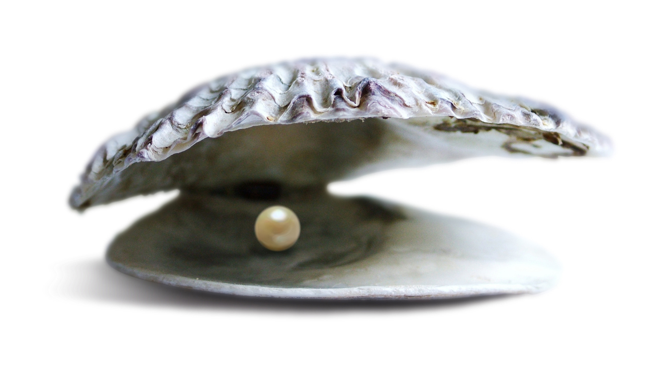
Sand in the Oyster
Dr. Bryan Rhodes

Slide 3
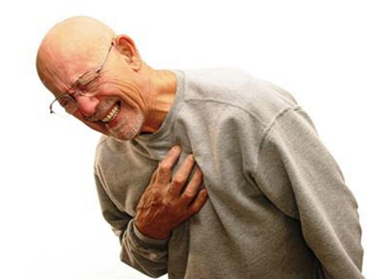

Slide 5
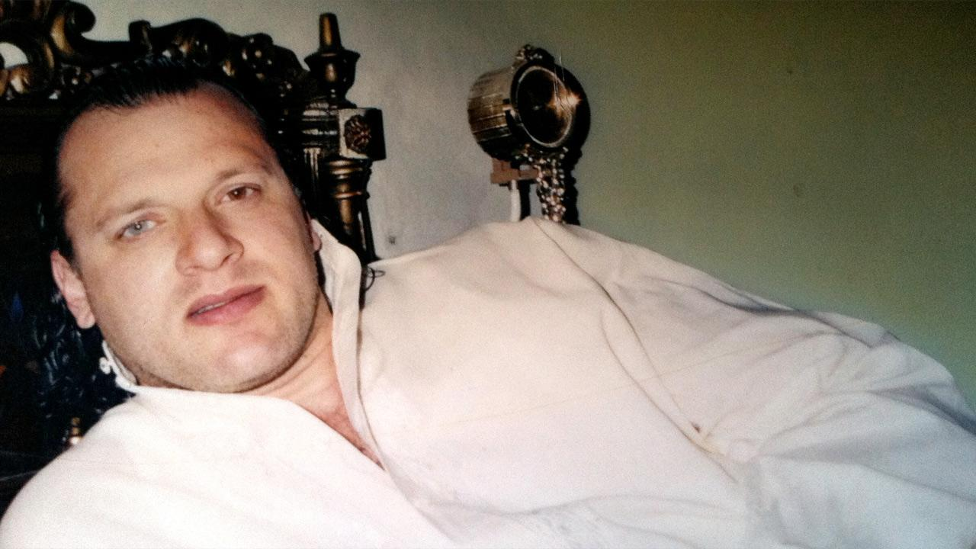
A Perfect Terrorist
David Headly

Slide 6
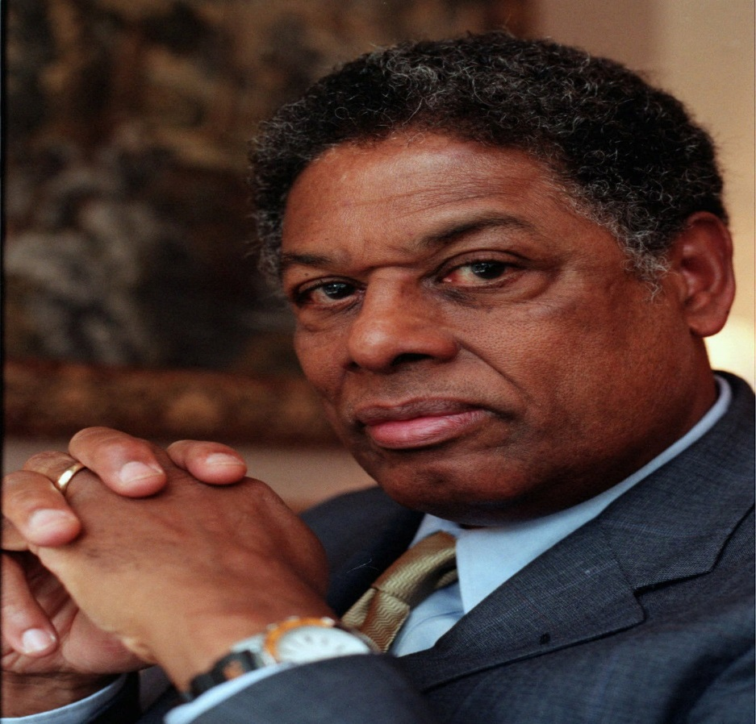
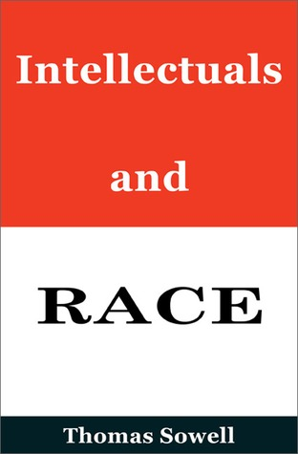
“Grounded not in reason, but on authority and publicly enforced orthodoxy.”
“Doctrine hardens into dogma”

Slide 7
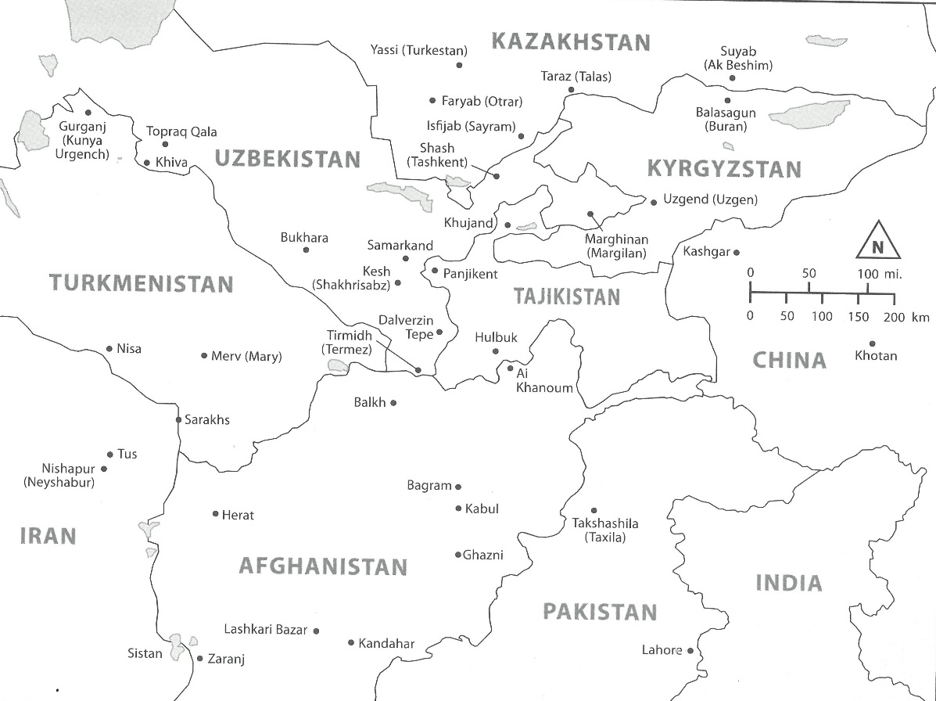
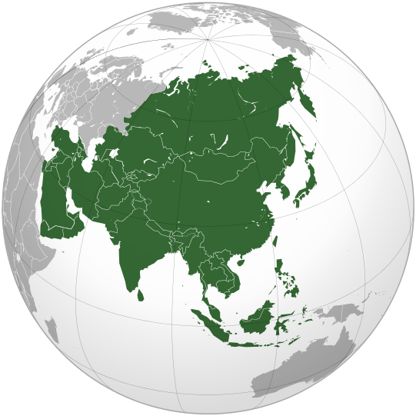
6th – 13th Centuries

Slide 8
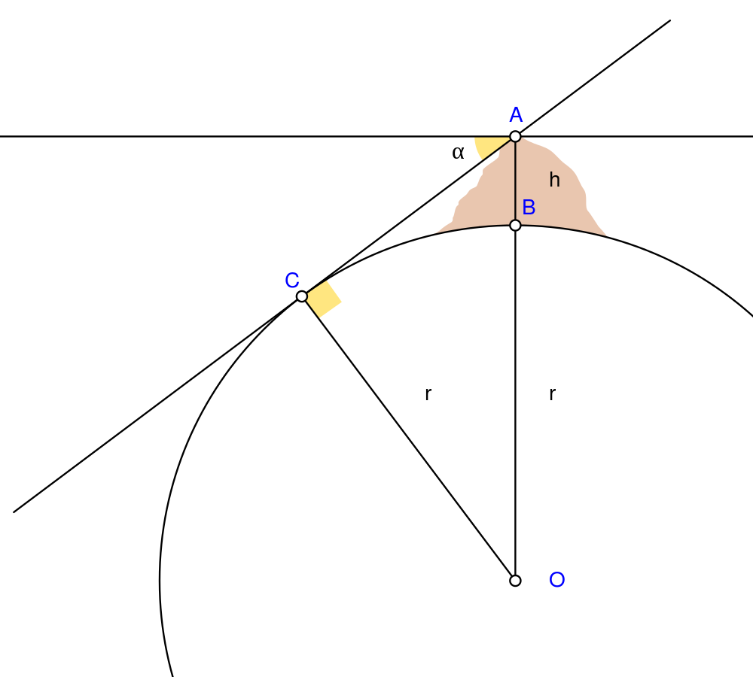
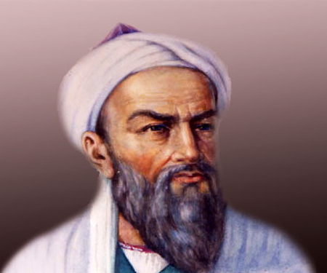
Biruni
“truths gained through observation and quantitative analysis.”

Slide 9
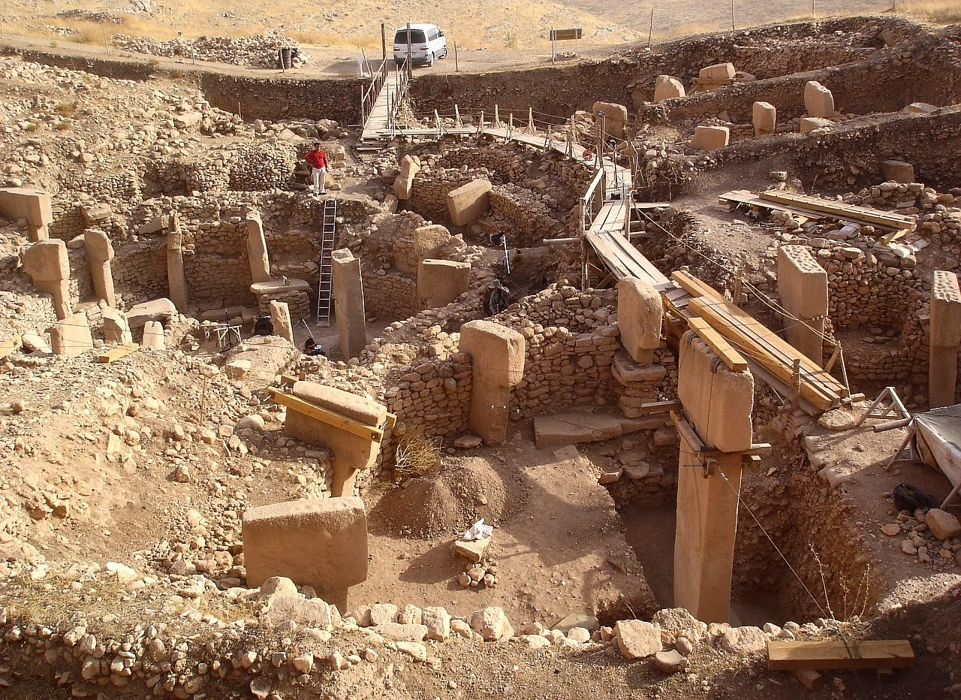
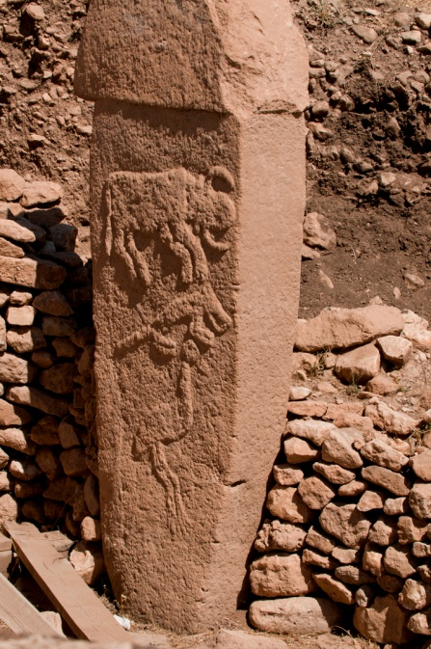
“Truth was treated as a complete and perfect whole that needed no further modification or elaboration.”
“reigning paradigms were so deeply entrenched, their unresolved loose ends so few and seemingly insignificant, and the discordant voices so weak, that stasis set in.”
Göbekli Tepe
12,000 BP

Slide 10
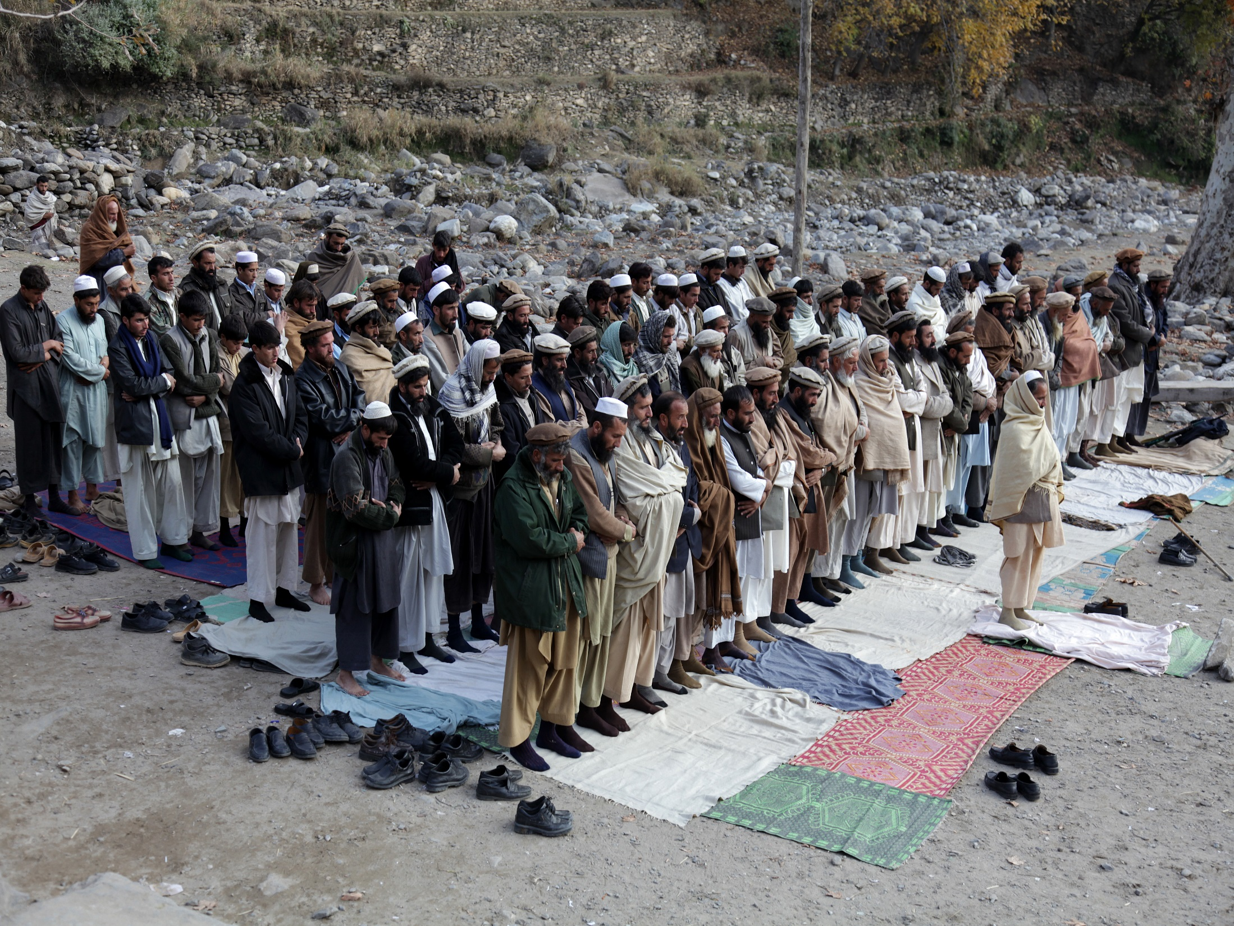
Can you breed someone to be religious?

Slide 11
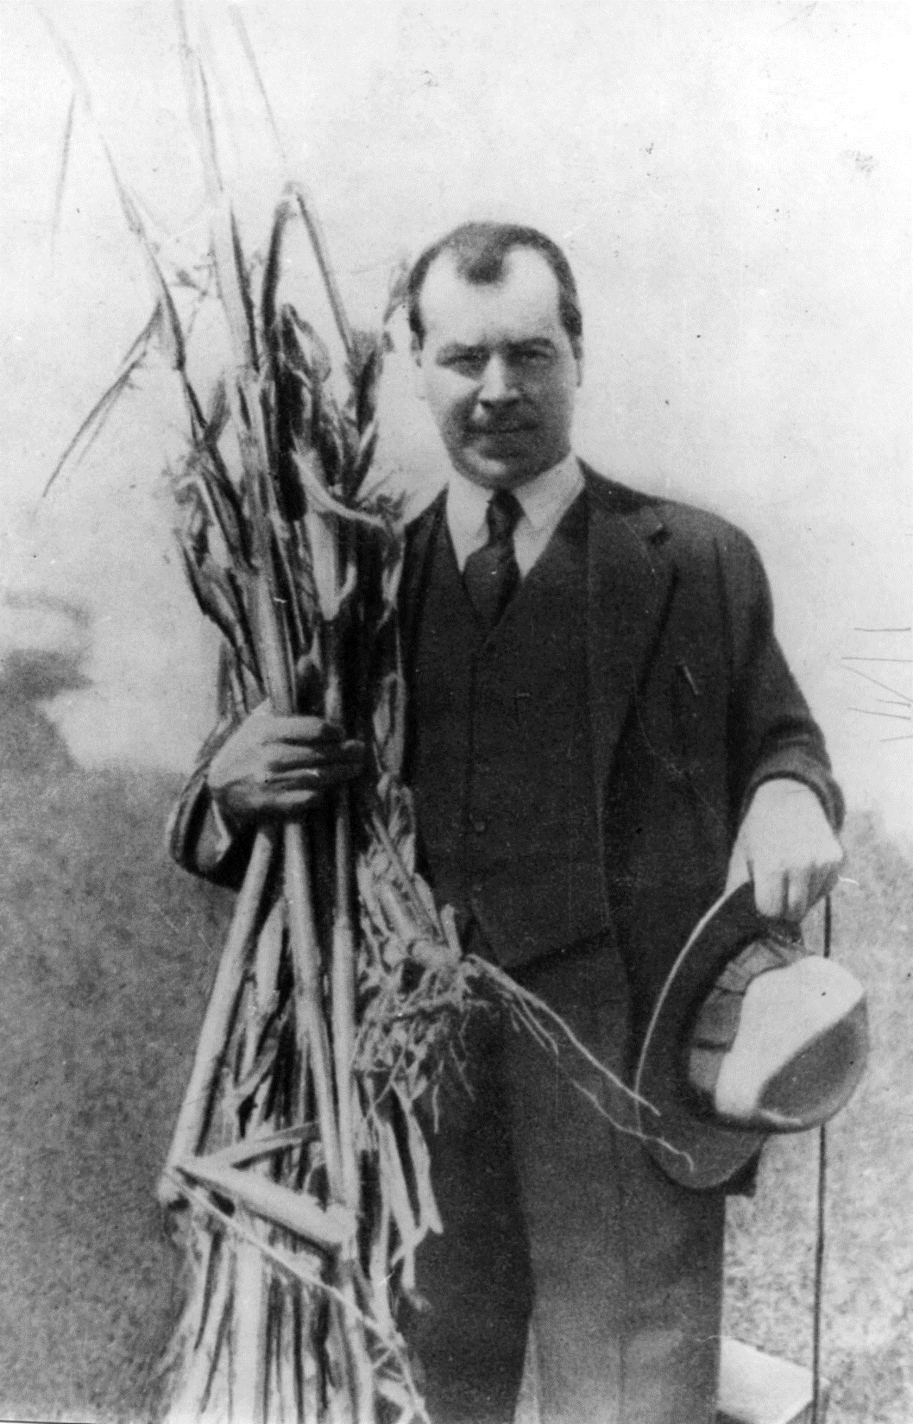
“Increasingly, ideological tests were brought to bear not only against individual thinkers and specific treatises and books they had written, but against whole fields of inquiry and, finally, against specific modes of thought. As mainstream orthodoxy hardened, the price of ideological deviance increased.”
Nikolai Vavilov

Slide 12
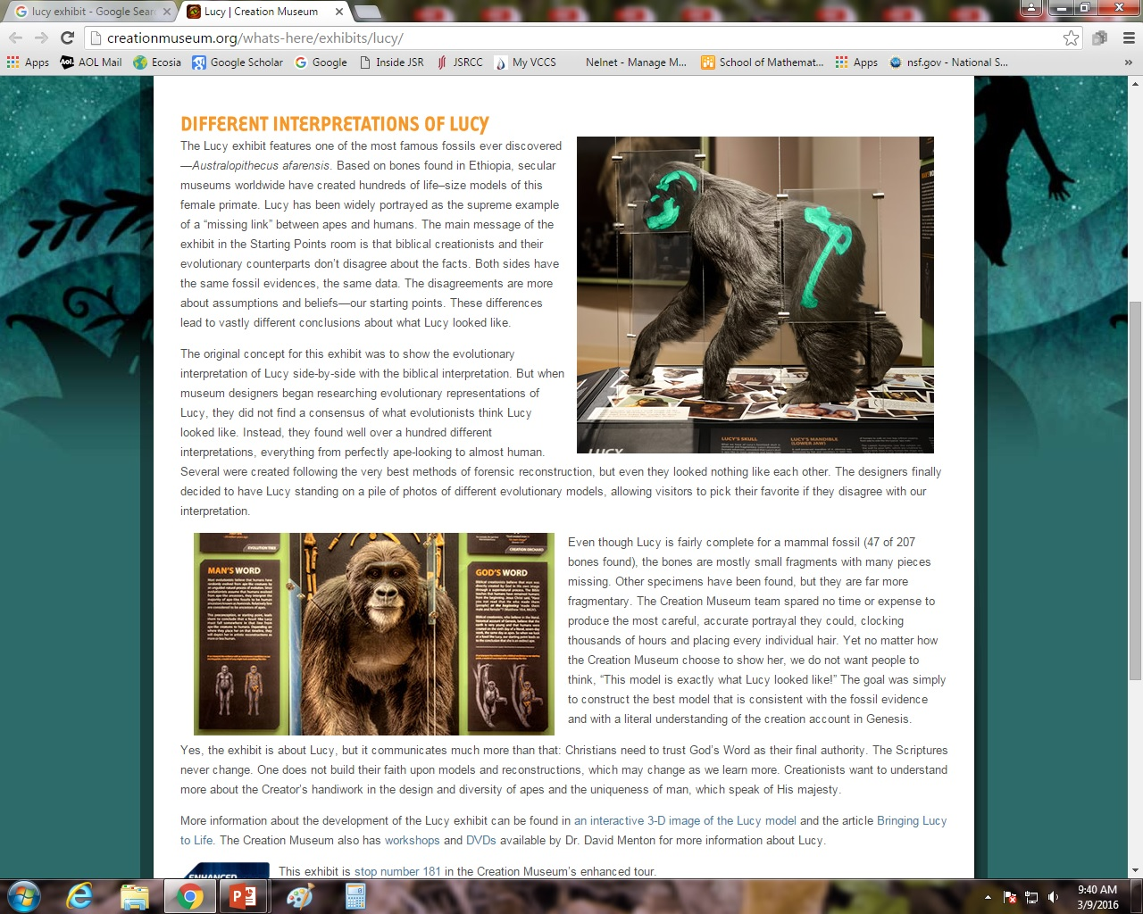
Faith, not science and rigorous thought, is the key to unlocking truth.
Requires submission, not sand in the oyster

Slide 13
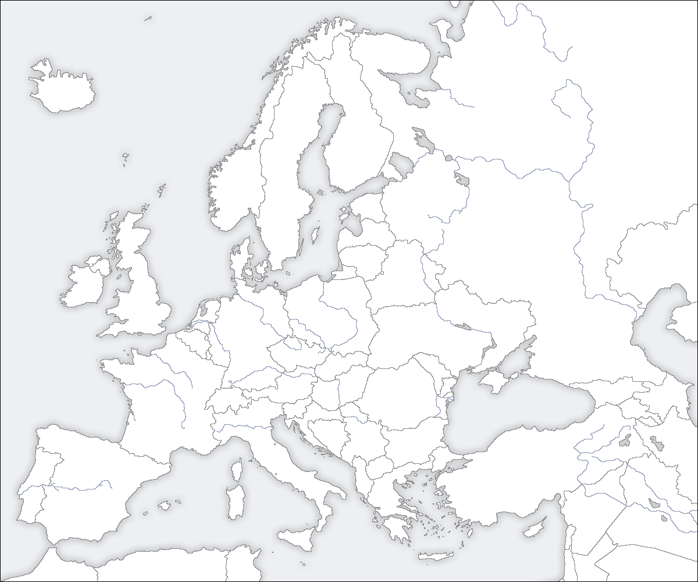
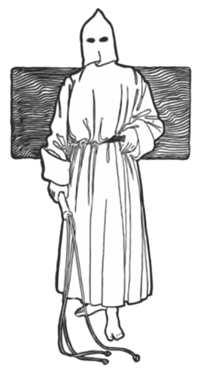
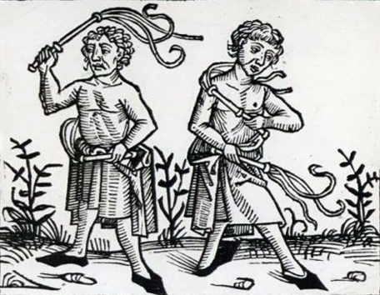
Flagellants
Germany and the Low Countries 1349
Perugia 1259

Slide 14
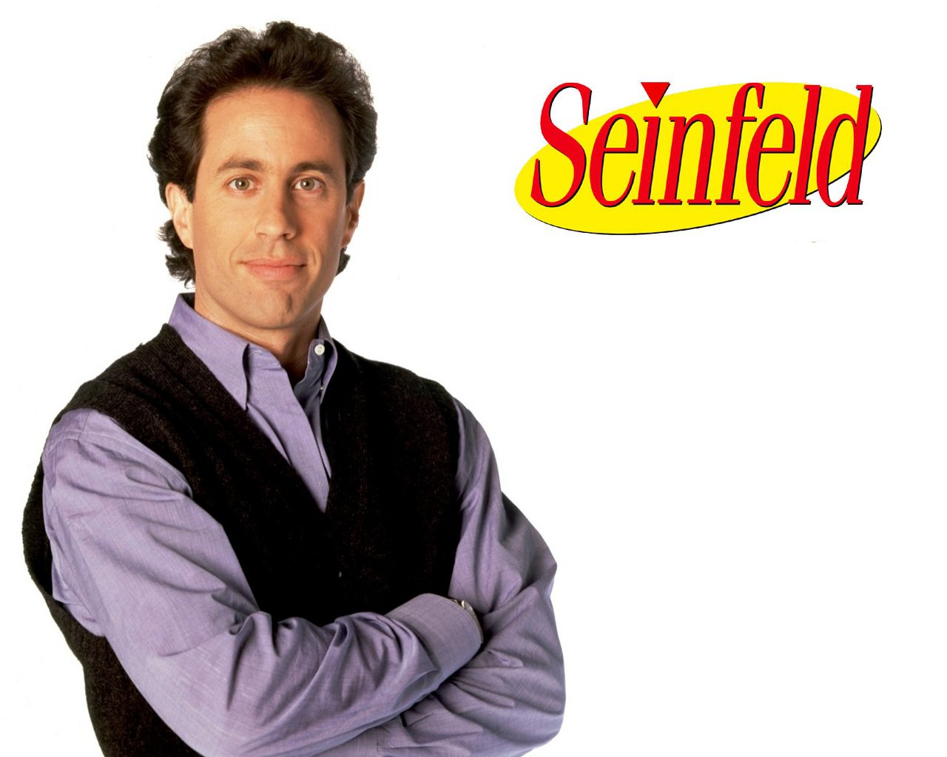

Slide 15
“Our culture has actually taught our kids to be this self-absorbed and narcissistic,” “Any time their feelings are hurt, they are victims! Anyone who dares challenge them and, thus, makes them ‘feel bad’ about themselves, is a ‘hater,’ a ‘bigot,’ an ‘oppressor,’ and a ‘victimizer.’”
40 percent of millennials support a crackdown on offensive speech
“…our obligation is to challenge bad thinking and bad ideas and not coddle individuals in their self-absorption and narcissism.”
The modern-day collegian is a fragile snowflake – who needs psychological help for such atrocities as reading the works of a white author or attending Taco Night at the campus dining hall.
“Do we want ideological fascism or do we want intellectual freedom and academic freedom,” he asked. “Because really what we have right now is an argument for ideological fascism. You must submit. You must agree. You must be one of us. And if you don’t, we will silence you. We will crush you.”
Dr. Everett Piper

Slide 16
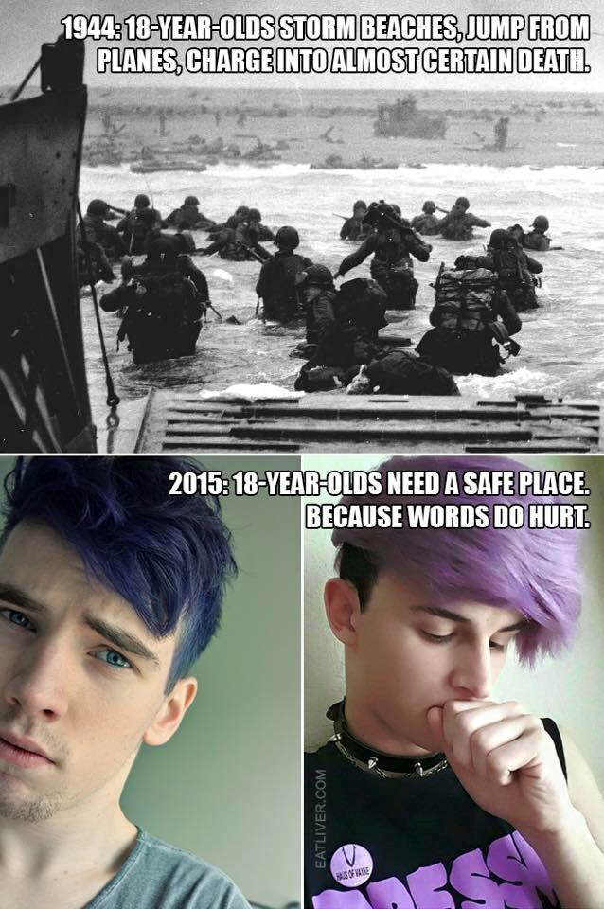

Slide 17
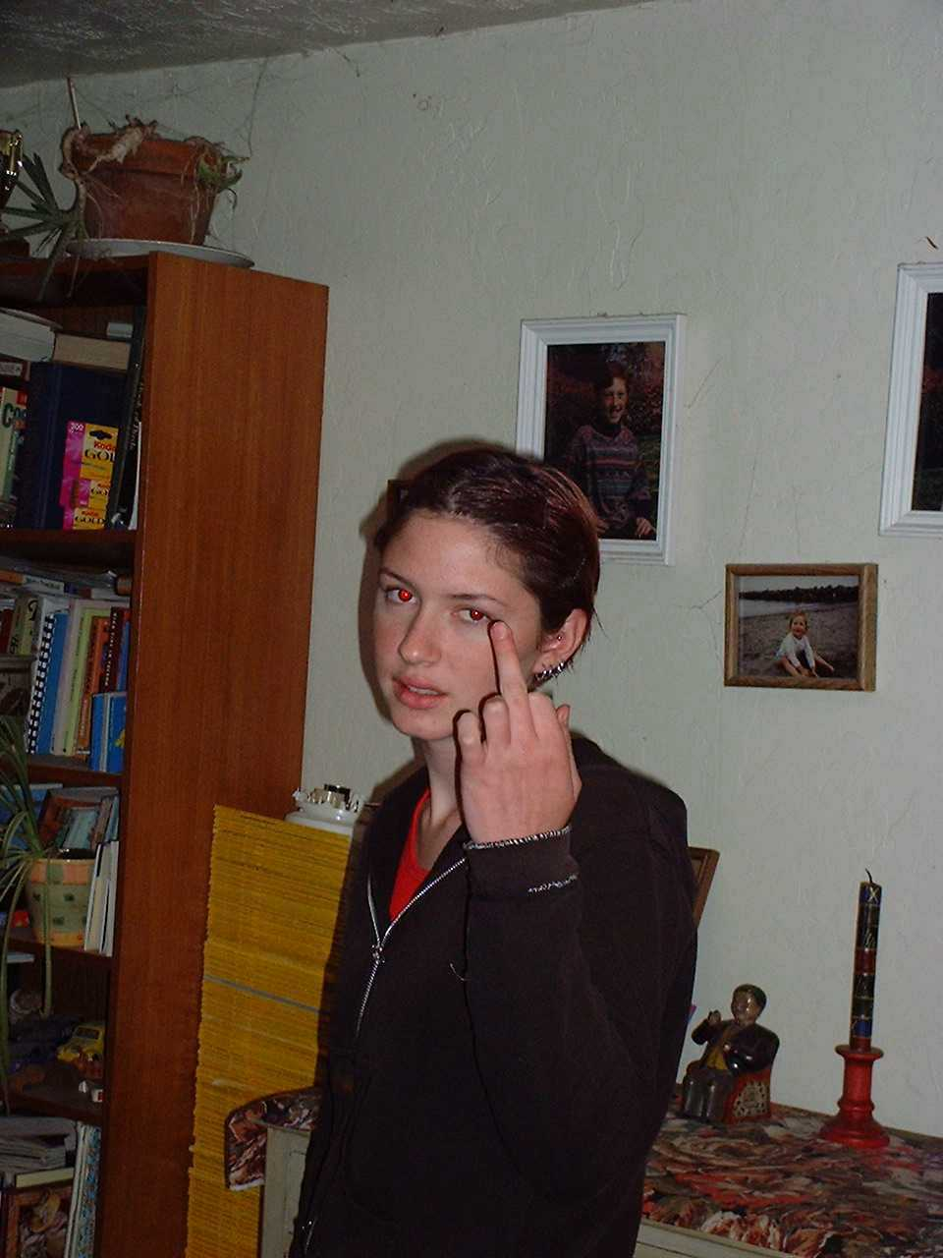
Step-Children

Slide 18
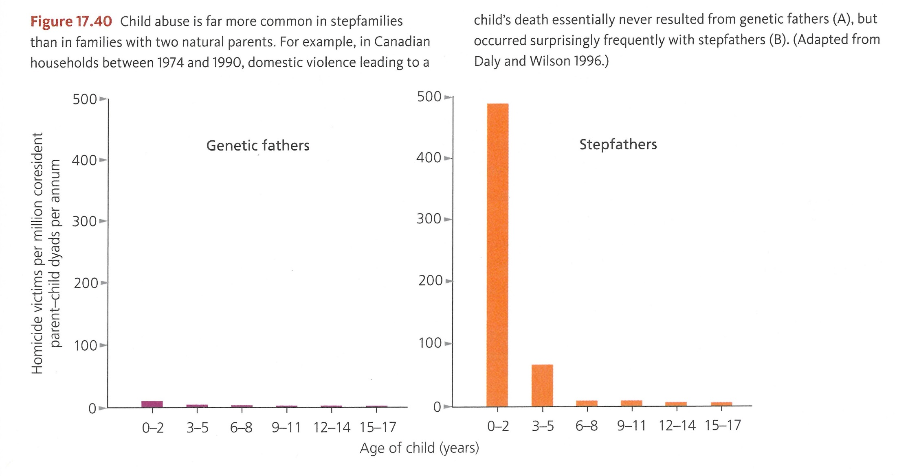

Slide 19
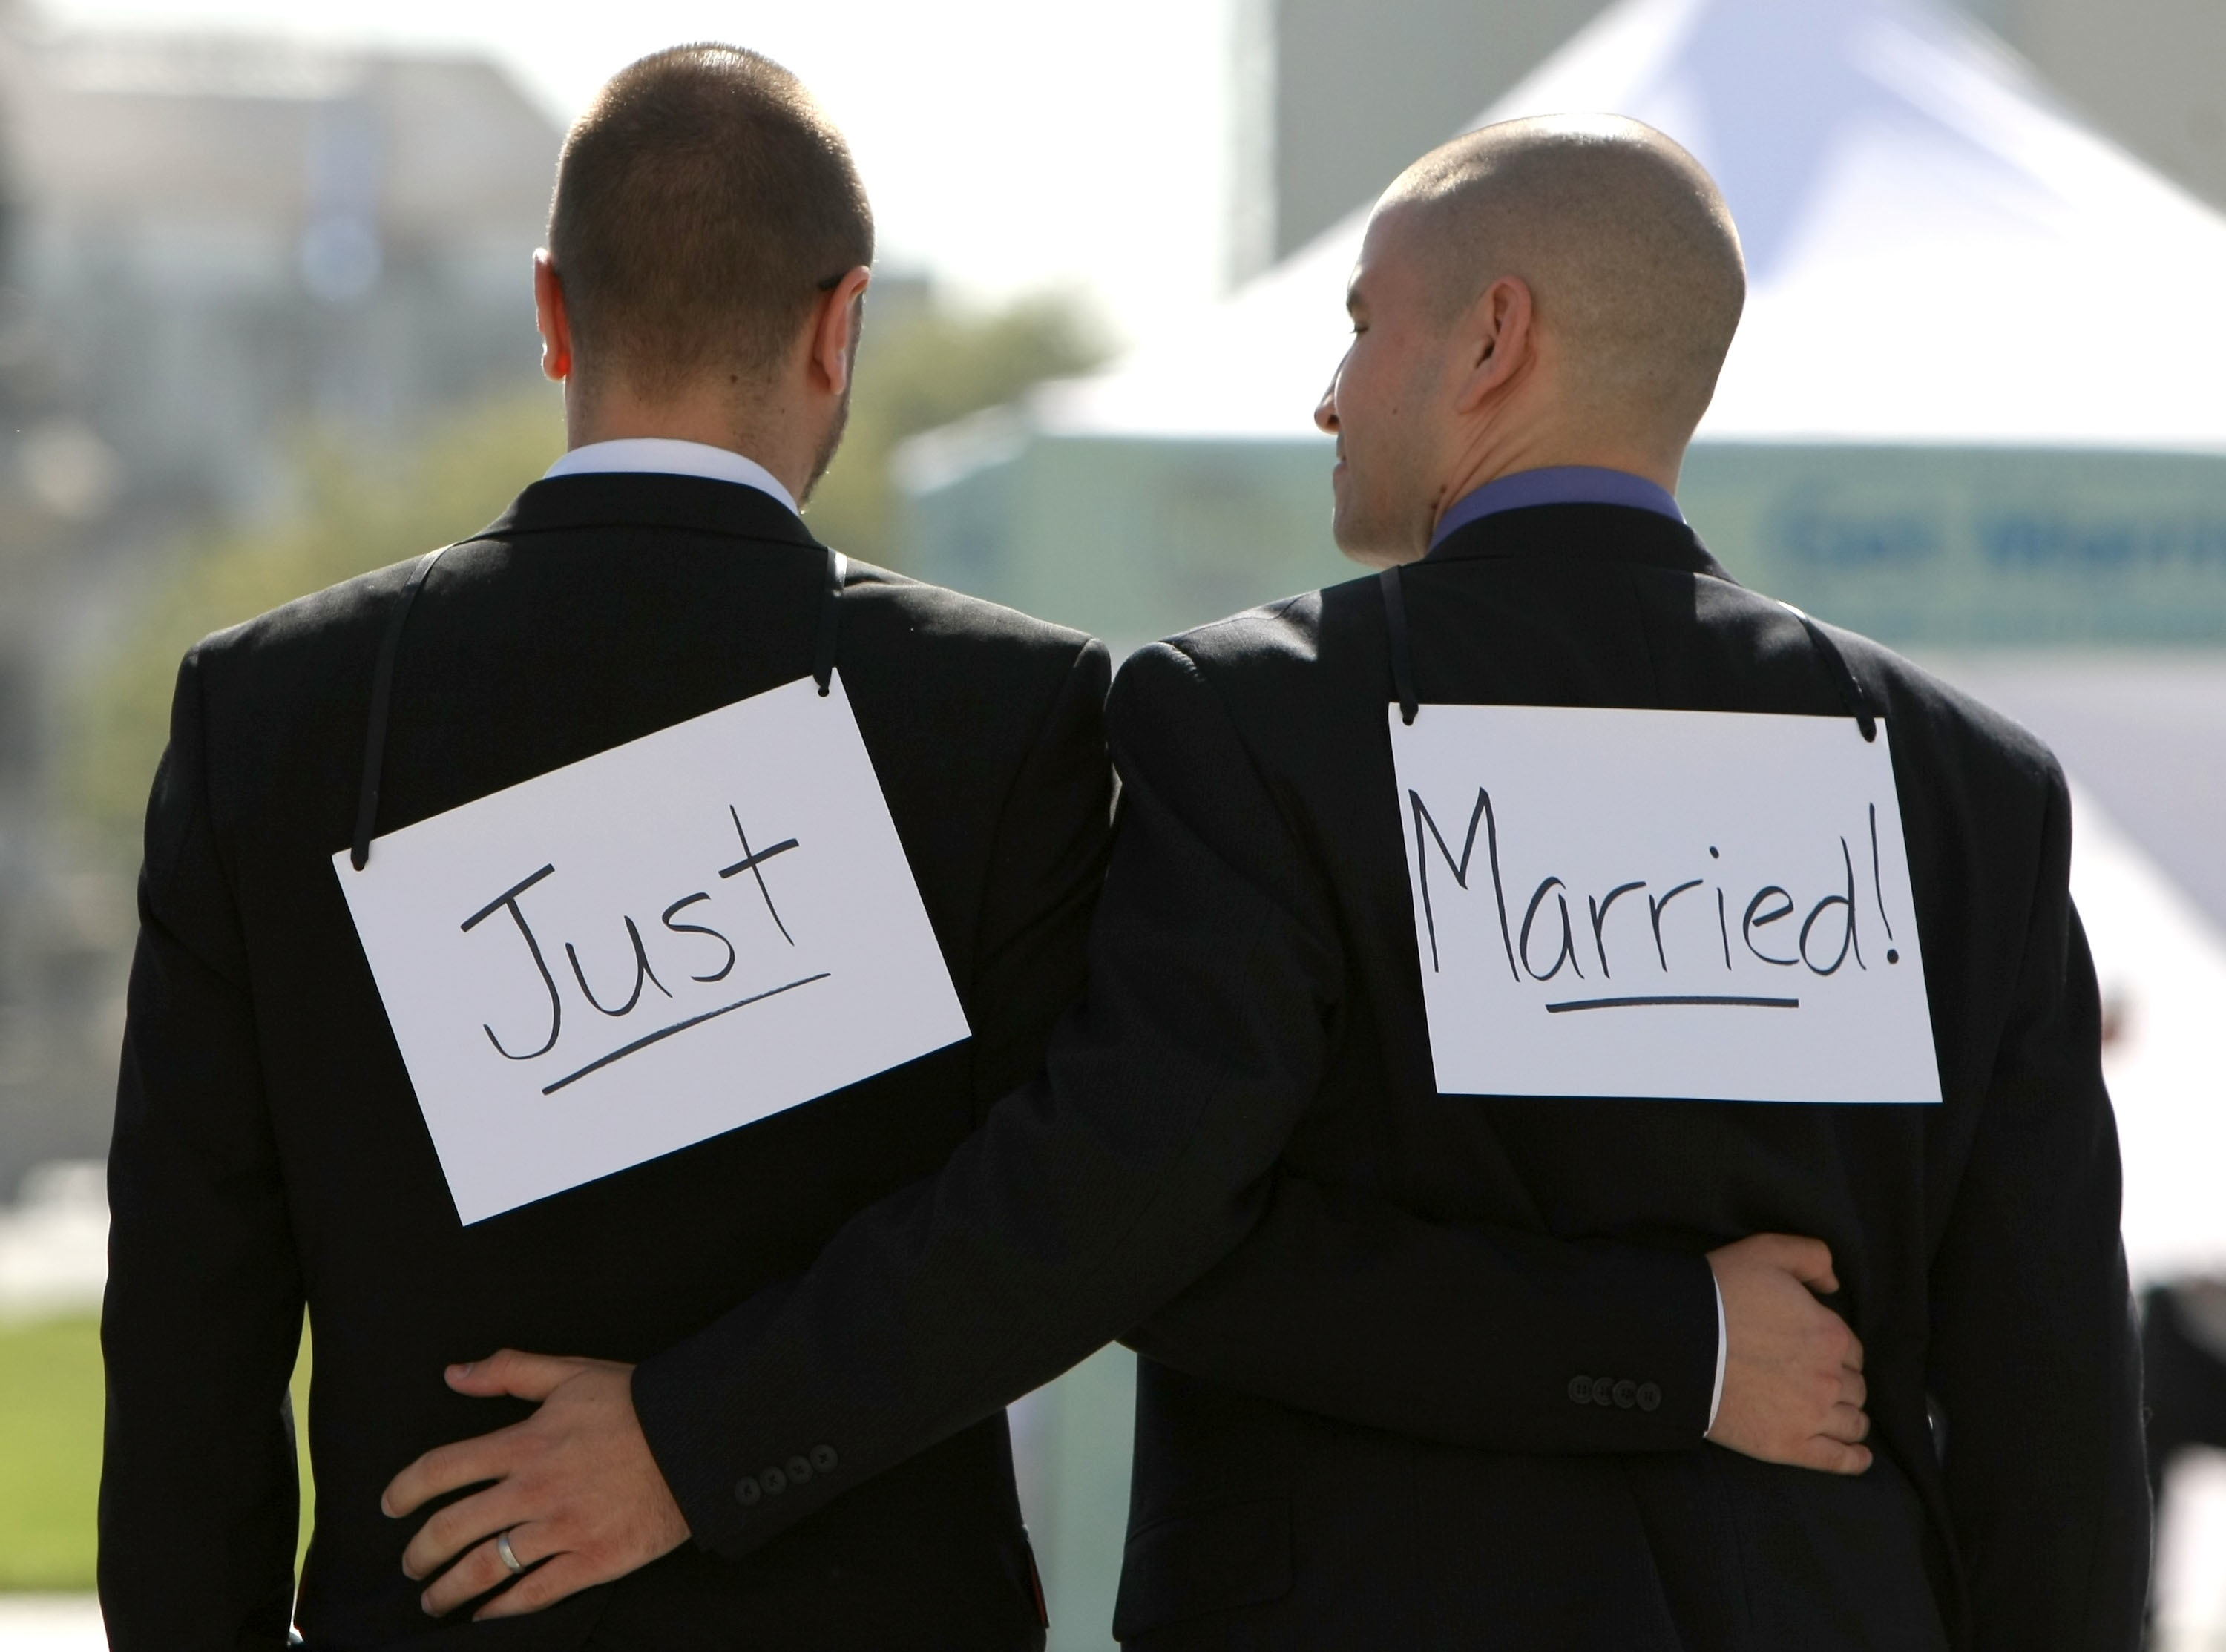
“Anomalies are seen as either an inconvenience or a treat and are therefore swept under the rug or repressed…some people resist what does not conform to their understanding of things, and other acknowledge inconvenient evidence and try to deal with it.”

Slide 20
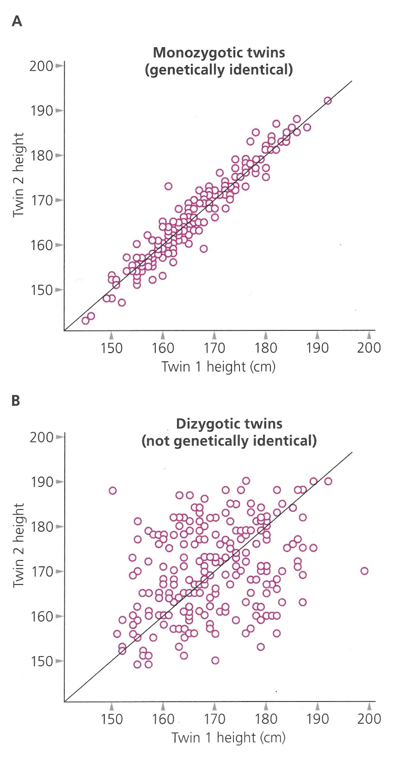

Slide 21
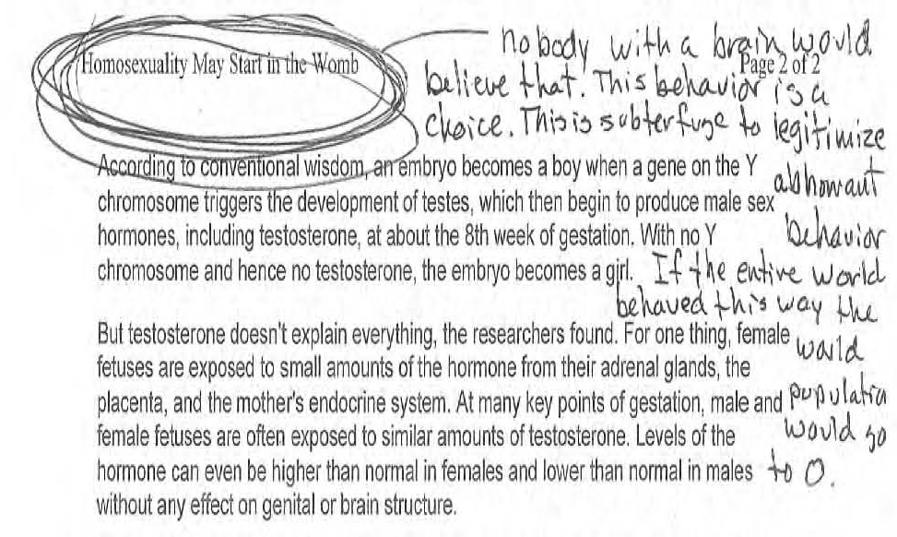

Slide 22
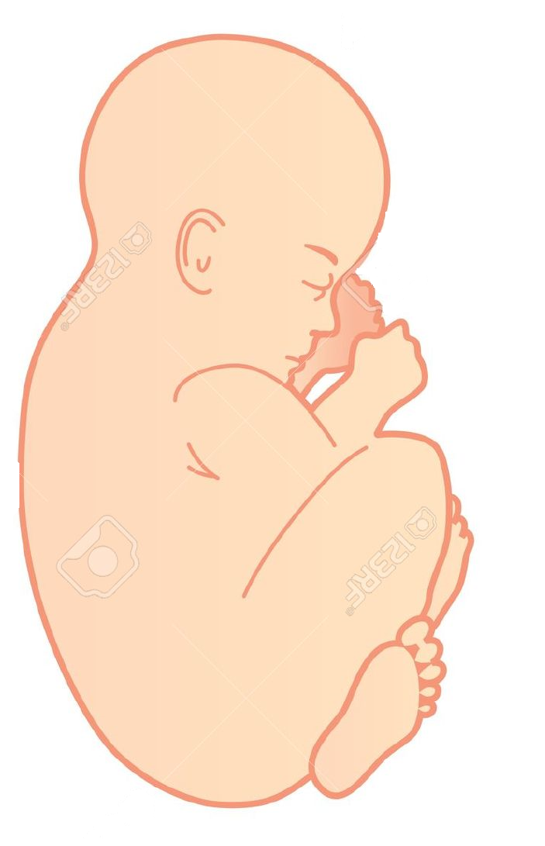

Slide 23
What extinguished the intellectual spark?

Slide 24
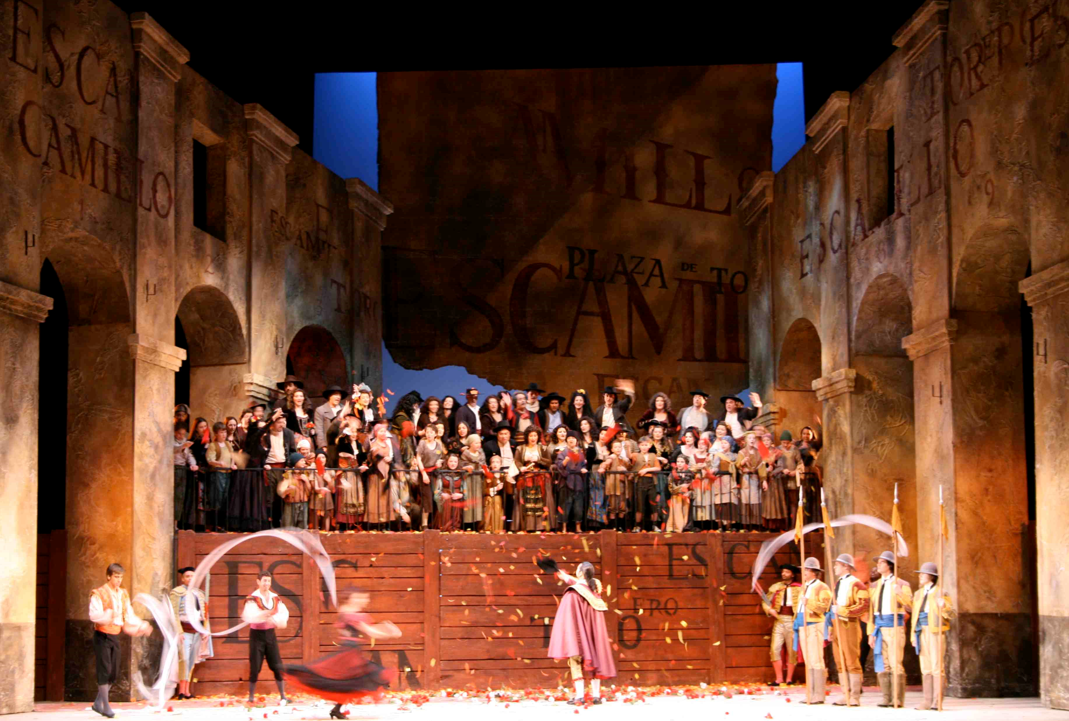
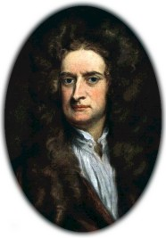

Slide 25
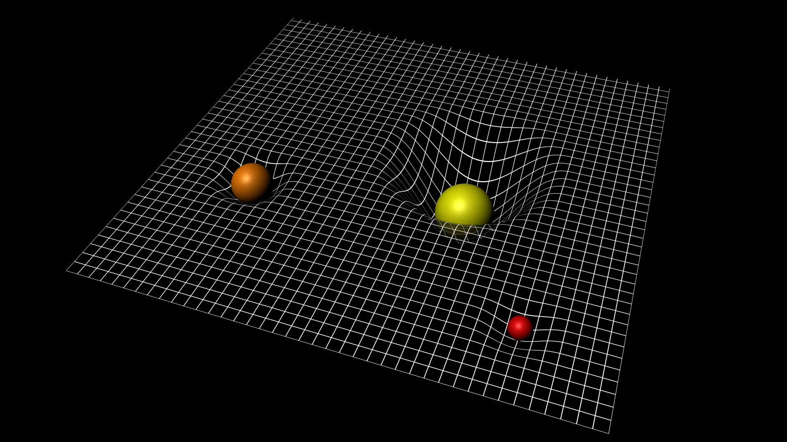
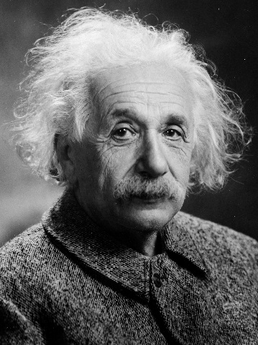

Slide 26
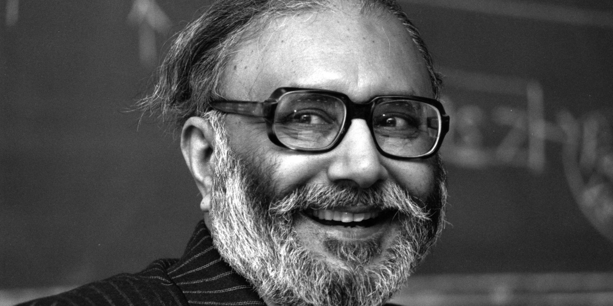
An active scientist is always right and the younger he is, the more right he is.
Abdus Salam

